Slide 1
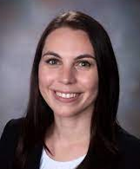
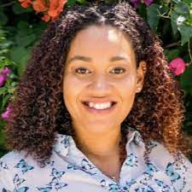
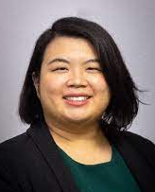
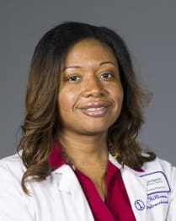
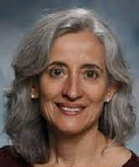
Nicholas Brutus MD Candidate Coordinator, National Center for Pre-Faculty Development | Ashley Rodgers MD Coordinator, Pre-Faculty Competencies and Milestones Project | Kaitlyn Pommells BA Coordinator, Academic Medicine Writing Fellowship
Joyce Pang MD Co-Director, Academic Medicine Writing Fellowship | Renee Williams MD Co-Director, Academic Medicine Writing Fellowship | Emine Abali PhD Co-Director, Academic Medicine Writing Fellowship

